Slide 1


CS689: Computational Linguistics for Indian Languages
UDAAN - Machine Learning based Post-Editing tool for Document Translation
(2022)
Presentation By:
DEEPAK PATNAIK BALARAMAMAHANTHI (231110010)
SHIVAM MISHRA (231110047)
NITISH KUMAR (231110033)
Dept:- M.Tech (CSE)
Instructor:
PROF.
ARNAB BHATTACHARYA

Slide 2

About the paper
Contributors:
Ayush Maheshwari Ajay Ravindran
Venkatapathy Subramanian Ganesh Ramakrishnan
Project UDAAN an initiative of IIT Bombay with the motto
"Breaking the Language Barrier in Education"
Udaan project enables translation of textbooks and learning materials, across English and all Indian languages.
This paper was published in March 2022 and presented at the 6th Joint International Conference on Data Science & Management of Data (CODS-COMAD 2023) held in Mumbai, India, from January 4-7, 2023
This paper describes the methodologies used in the UDAAN Project.

Slide 3
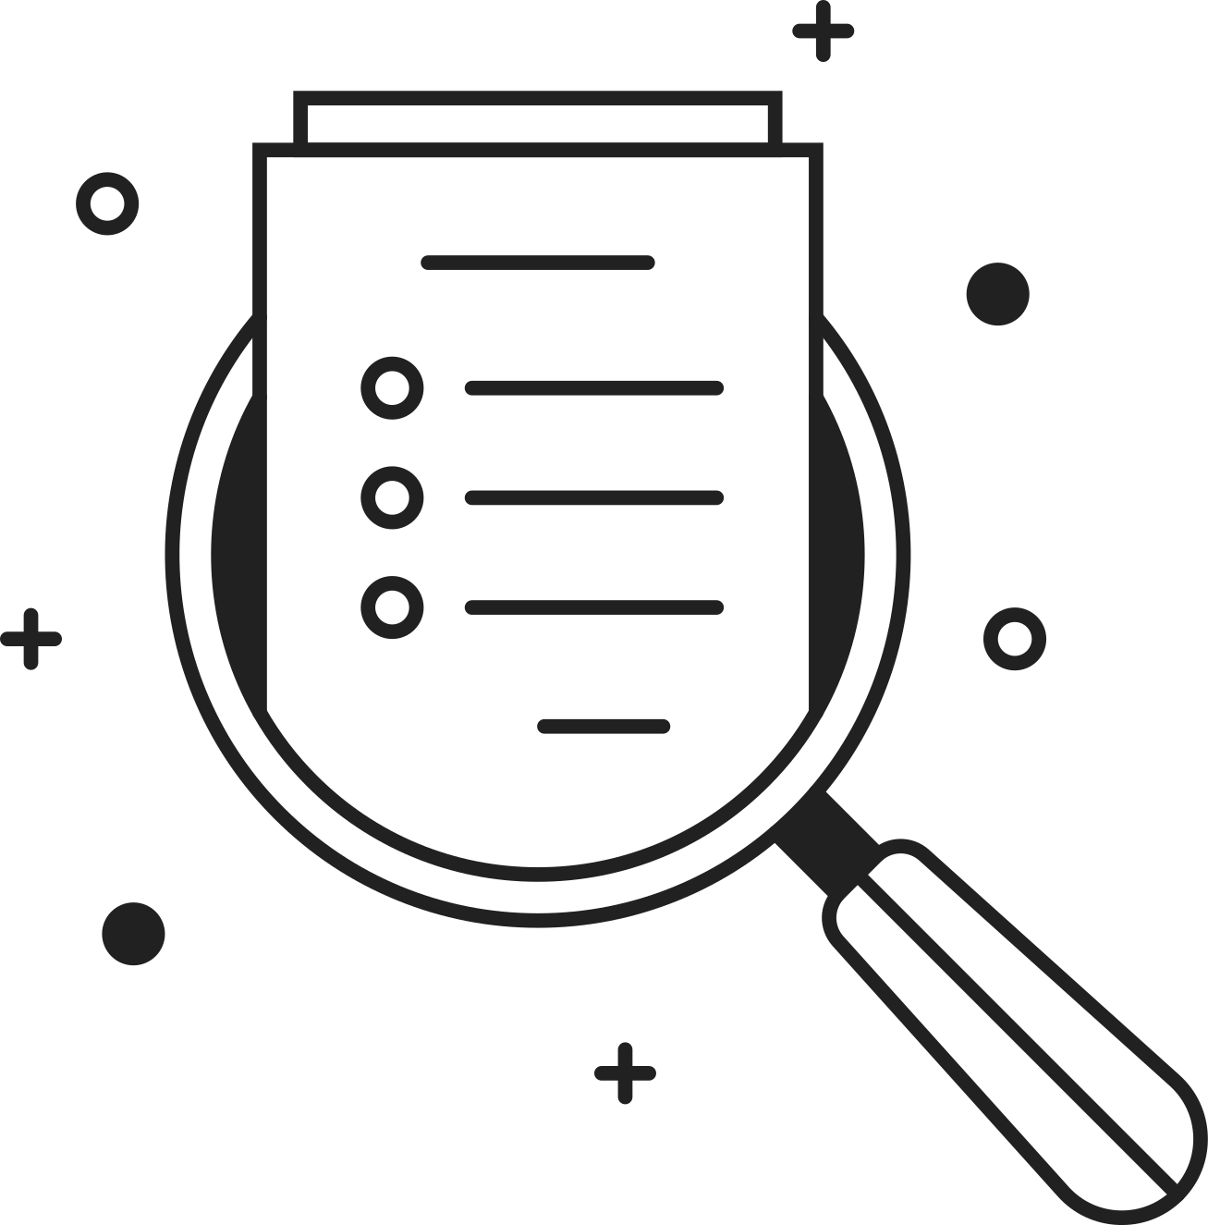
Overview
UDAAN is an open-source post-editing tool,designed to streamline the process of editing documents in various Indic languages.
It aims to minimize manual editing efforts and generate high-quality documents quickly, independent of the source and target languages.
It has an end-to-end Machine Translation (MT) plus post-editing pipeline wherein users can upload a document to obtain raw MT output,so that users can edit the raw translations using this tool.

Slide 4

Existing Approaches
Neural-based machine translation
  A method of automatically translating text from one language to another using artificial neural networks,trained over large corpus to learn the patterns and relationships between words and phrases.
  NMT systems have significantly enhanced translation performance, but the quality falls short of human translation standards.
  NMT models can produce generic translations that may not adhere to specific domain terminologies.
Using CAT
  Software used to assist a human translator in the translation process of large volume of text more efficiently.
  Current CAT tools employ translation memory (TM) to store translated pairs for future use, resembling a find-and-replace function between languages.
  CAT tools are neither designed for long document translations nor accept source documents in PDF or other difficult-to-parse formats.

Slide 5
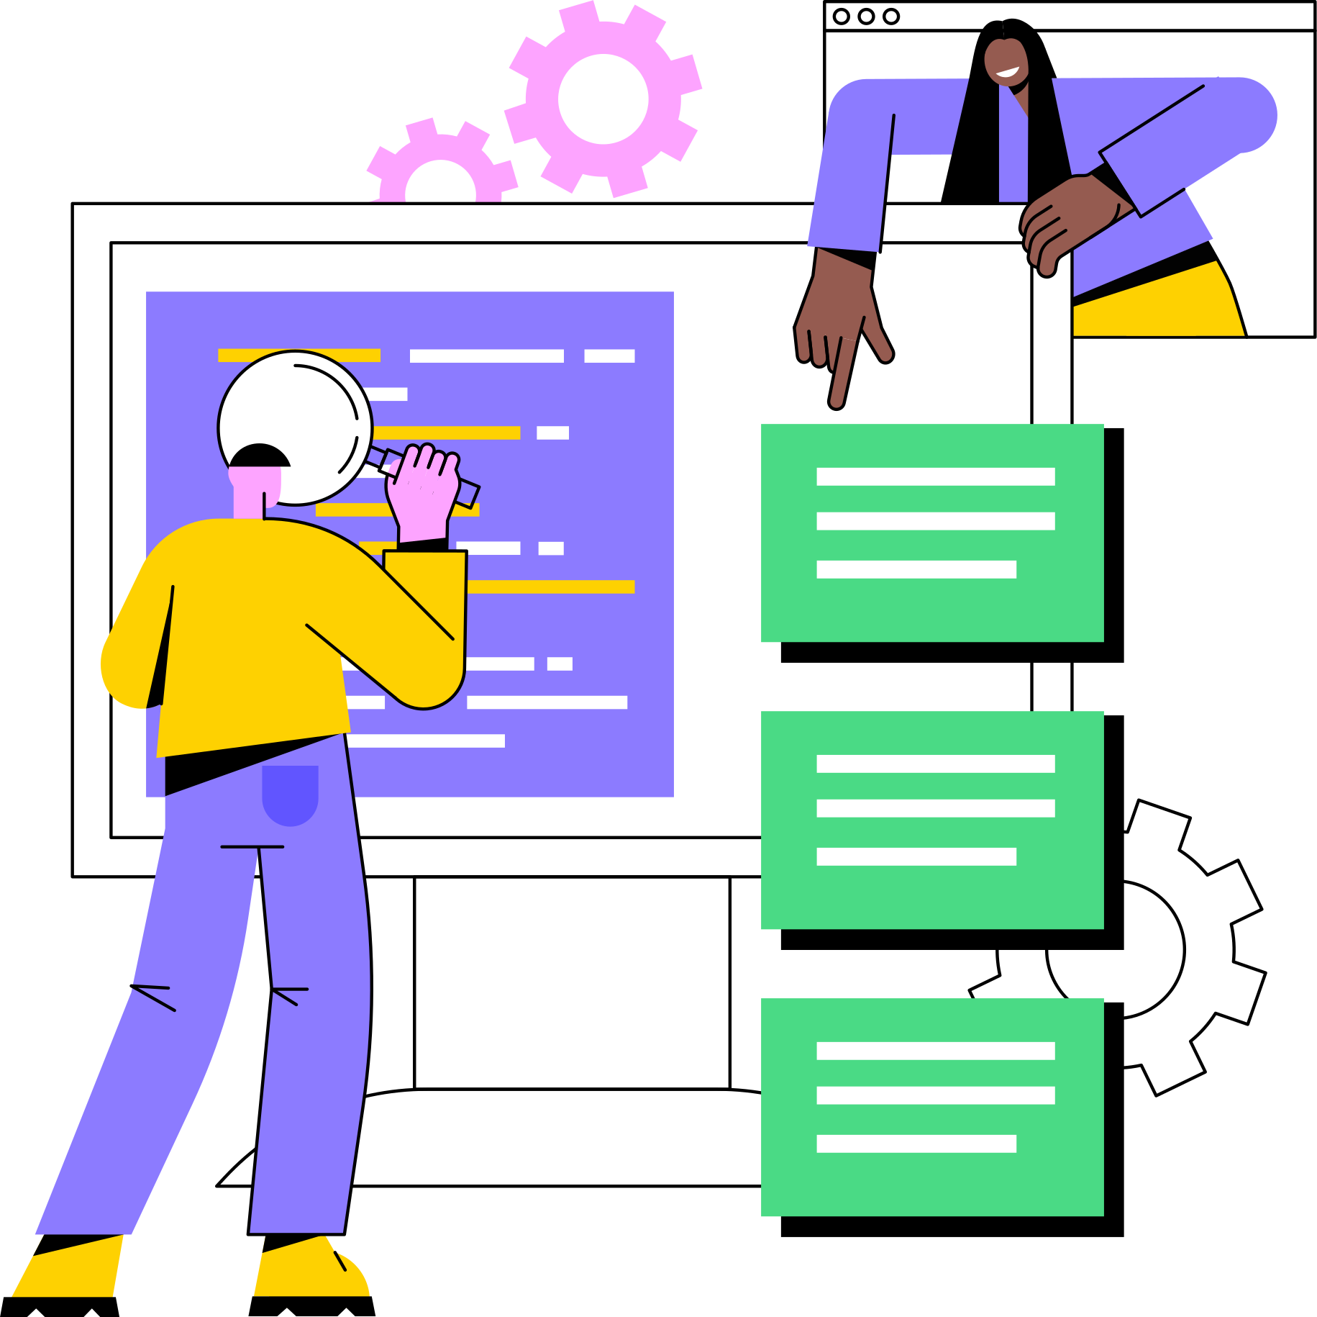
UDAAN Features
  Interactive Translation: Learns the user edit patterns to suggest either global replacements or local suggestions for replacements, ultimately reducing editing time and ensuring consistency in the edited output.
  Lexically Constrained Translation model:
  Domain-aware Lexicon Suggestions
  Sentence Alignment: highlight sentences in the source as well as the translated documents together.
  Rich Text Formatting: It allows adding images, equations, tables etc., and allows cropping and resizing of image; export the final post-edited document in various popular formats such as docx, pdf, latex, etc.
  Offline working and sync facility
  Multiple roles:
- Correctors: who edits a document
- Verifiers: who validate the output from Correctors
- Proofreaders- who validate the final translated
document.

Slide 6
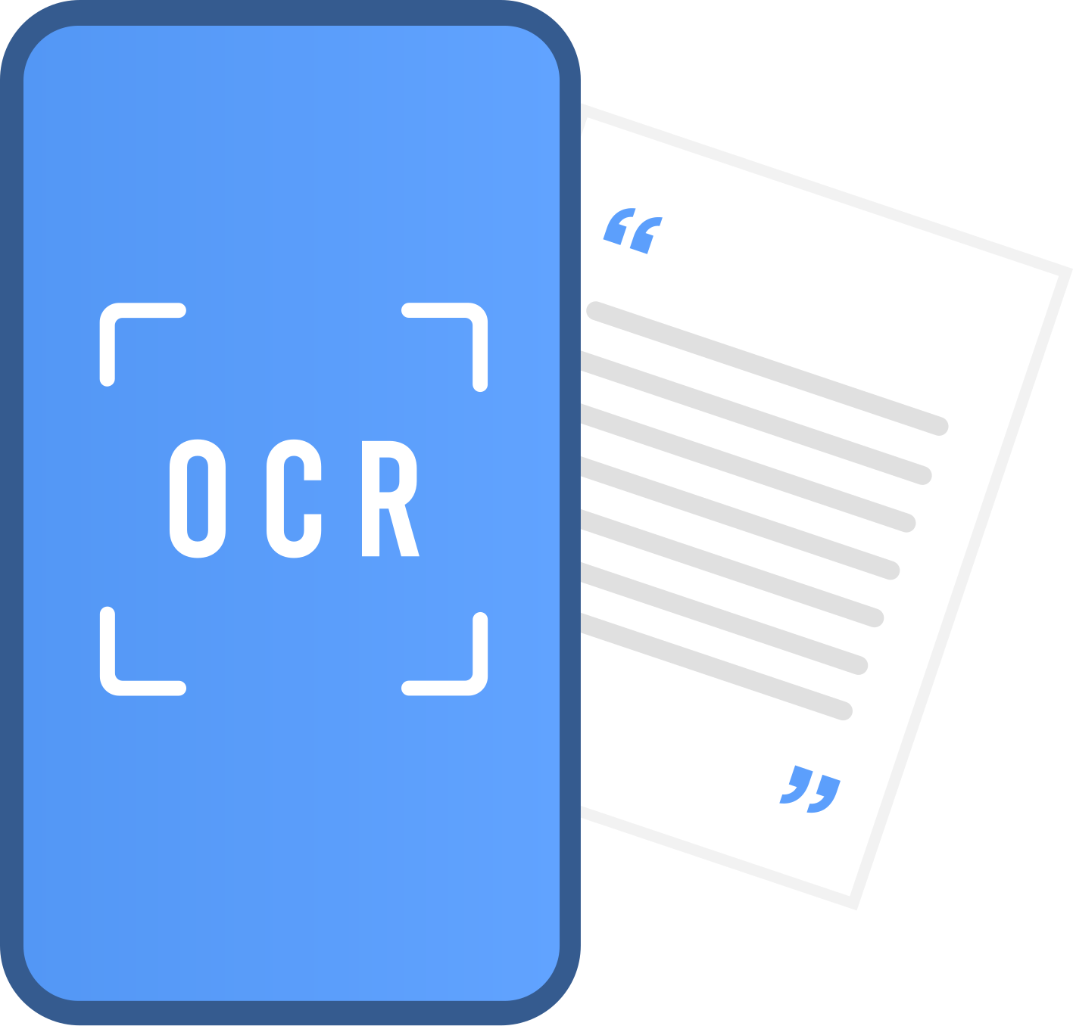

System Description
  PDF and Image Processing: Supports uploading of PDFs and images, converting them to editable text using Tesseract 4, an LSTM-based OCR engine, enhanced with a fine-tuned Devanagari model.
  Bilingual NMT Training: Utilizes the Samanantar corpus with 8.46 million English-Hindi parallel sentences to train a bilingual NMT model on fairseq with Transformer architecture.
  Advanced Model Configuration: Features a robust model with 6 encoder and decoder layers, 8 attention heads, 512-size input embeddings, and a 2048-neuron feedforward layer.
  Lexical Constraint Handling: Employs alignment-based constraint decoding to incorporate domain-specific terminology, improving translation relevancy without needing domain-specific training.
Optical Character Recognition
Lexically constrained translation

Slide 7

System Description
  Advanced Alignment Technique: Utilizes AwesomeAlign, an unsupervised method fine-tuned with multilingual BERT embeddings on the Samanantar dataset, enhancing word alignment accuracy which optimizes word alignment by promoting similarity and minimizing incorrect matches through mask language modeling and self-training objectives.
  Bidirectional Alignment Inference: Implements a bidirectional approach, using intersections of source-to-target and target-to-source alignment matrices with a greedy algorithm for precise word alignment.
Word Alignment
Inference

Slide 8
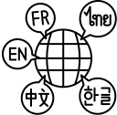

System Description
  Versatile Translation Memory (TM) Integration: Supports incorporating translation memory at the document level, utilizing word alignment for source-target translation induction, and enhancing post-editing efficiency.
  Comprehensive Domain-Specific Lexicons: Offers access to over 100 lexicons across fields like Physics, Chemistry, and Computer Science, aiding in accurate technical translations.
  Unique Lexicon Highlighting: Identifies and highlights words from selected domain-specific lexicons in green, ensuring clarity and ease of reference during the translation process.
Translation Memory
Domain specific lexicon

Slide 9
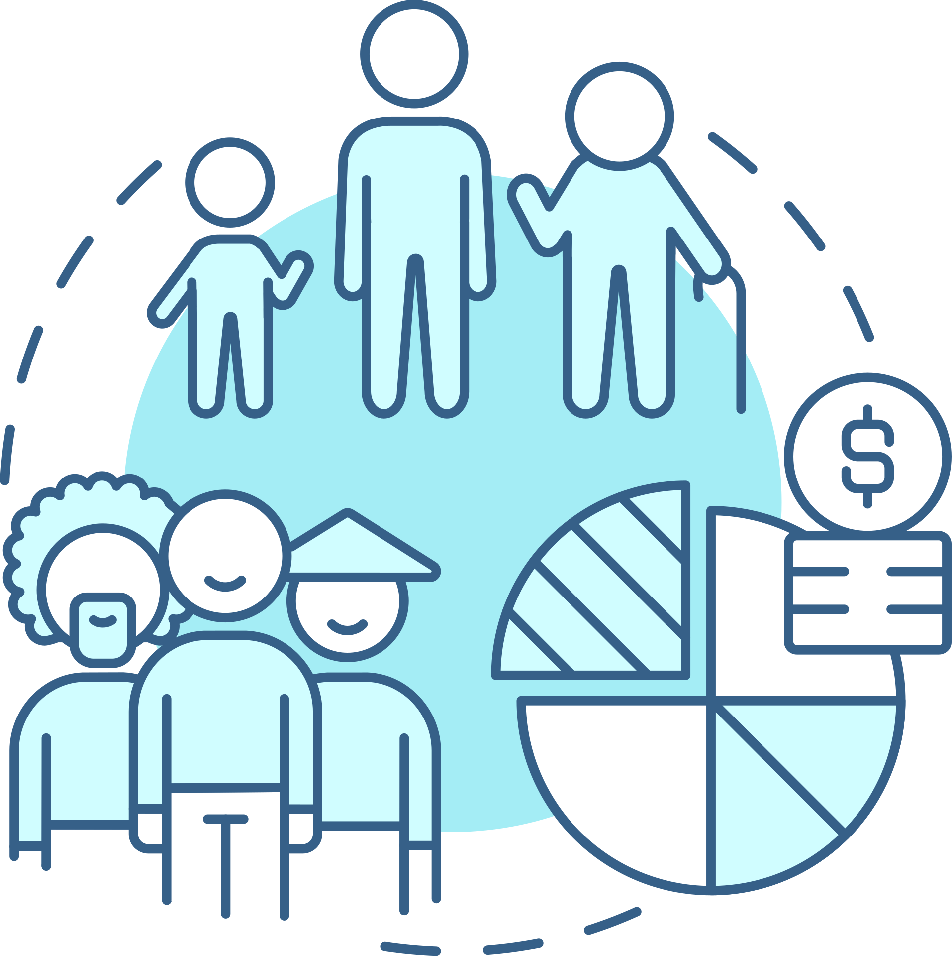

System Description
Global replacement
of edit segments
  Edit Replacement Options: Users can modify and opt for word replacements on the current page, unedited pages, or globally across the document, with a preview for informed decision-making.
  Comprehensive Logging: Logs include details such as the number of edits per page, time spent on each page, and information about word replacements, etc.
  Multi-user Collaboration: Supports simultaneous editing by multiple users on different document pages, enhancing teamwork and efficiency.
  Local and Remote Saving: Edits are saved locally and can be pushed to a remote Git repository, allowing for continuous collaboration and version control across post-editing projects.
Logging and Multi-user access

Slide 10

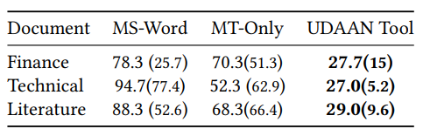

User Study
  Comparative Efficiency: UDAAN significantly enhances translation speed by about threefold compared to traditional methods like direct typing in MS-Word or editing machine-translated outputs.
  Diverse Participant Background: The study involved 6 bilingual users aged 25-50 from various sectors, demonstrating UDAAN's broad applicability across different professional domains.

Slide 11
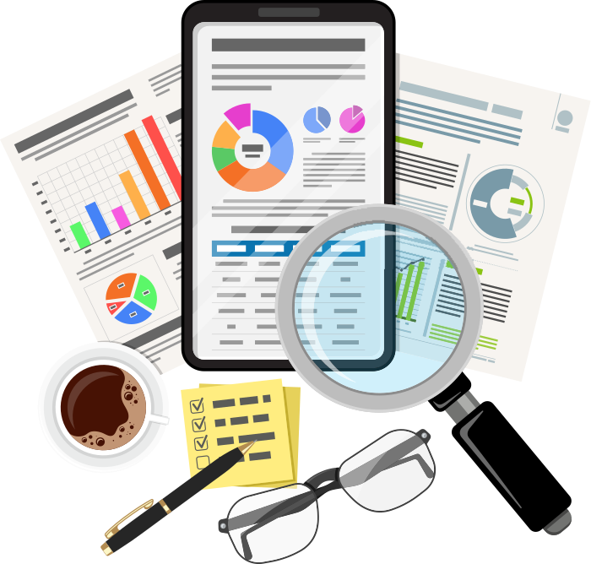
Our Analysis
  UDAAN addresses the issue of over-recycling in computer-aided translation (CAT) systems caused by excessive reliance on Translation Memory (TM) systems, which can result in poor translation quality and inconsistency. It circumvents this problem by enabling users to incorporate domain-specific lexicons during raw machine translation generation.
  The tool requires the user to select the source and target language of translation,but they could have made it auto-recognizable,as it becomes a problem in case of code-mixing.
  UDAAN couldn’t identify spelling corrections in languages other than english while translating-The reason might be server error.
  We tested the UDAAN with transliterated english text ,it gave accurate results and also the same is the case with Google Translator

Slide 12
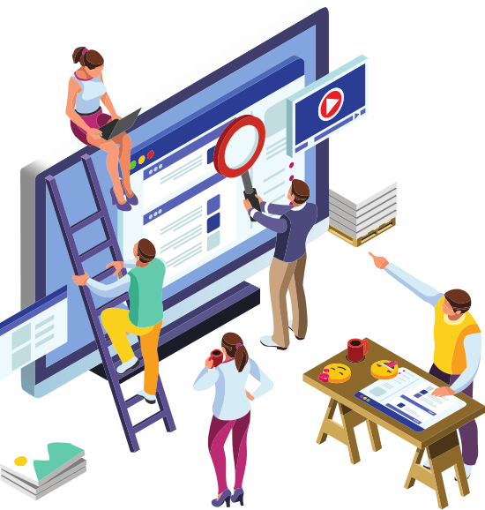
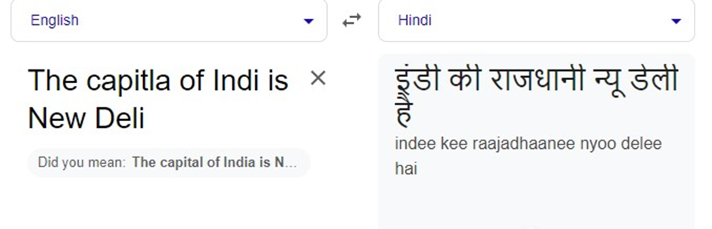
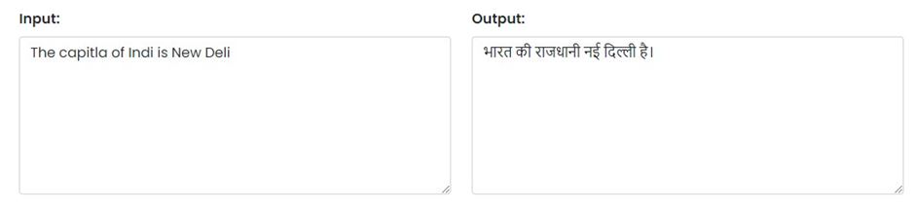
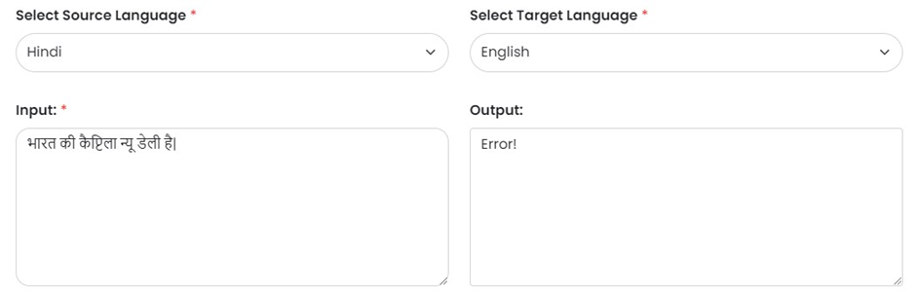
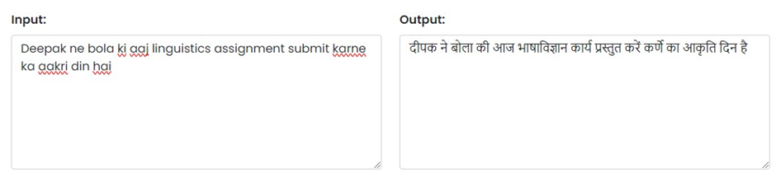
UDAAN Tool
Spelling mistake identification and correction is more accurate in UDAAN(only for english language) compared to other translators like Google Translator.
UDAAN couldn’t identify spelling corrections in language other than english
Transliterated text

Slide 13

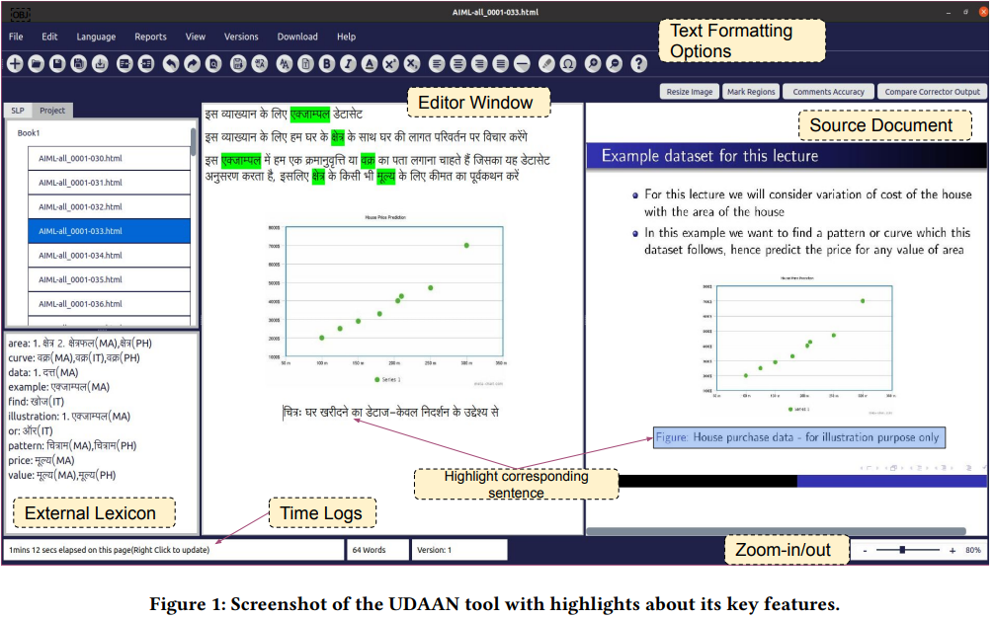
UDAAN Tool

Slide 14

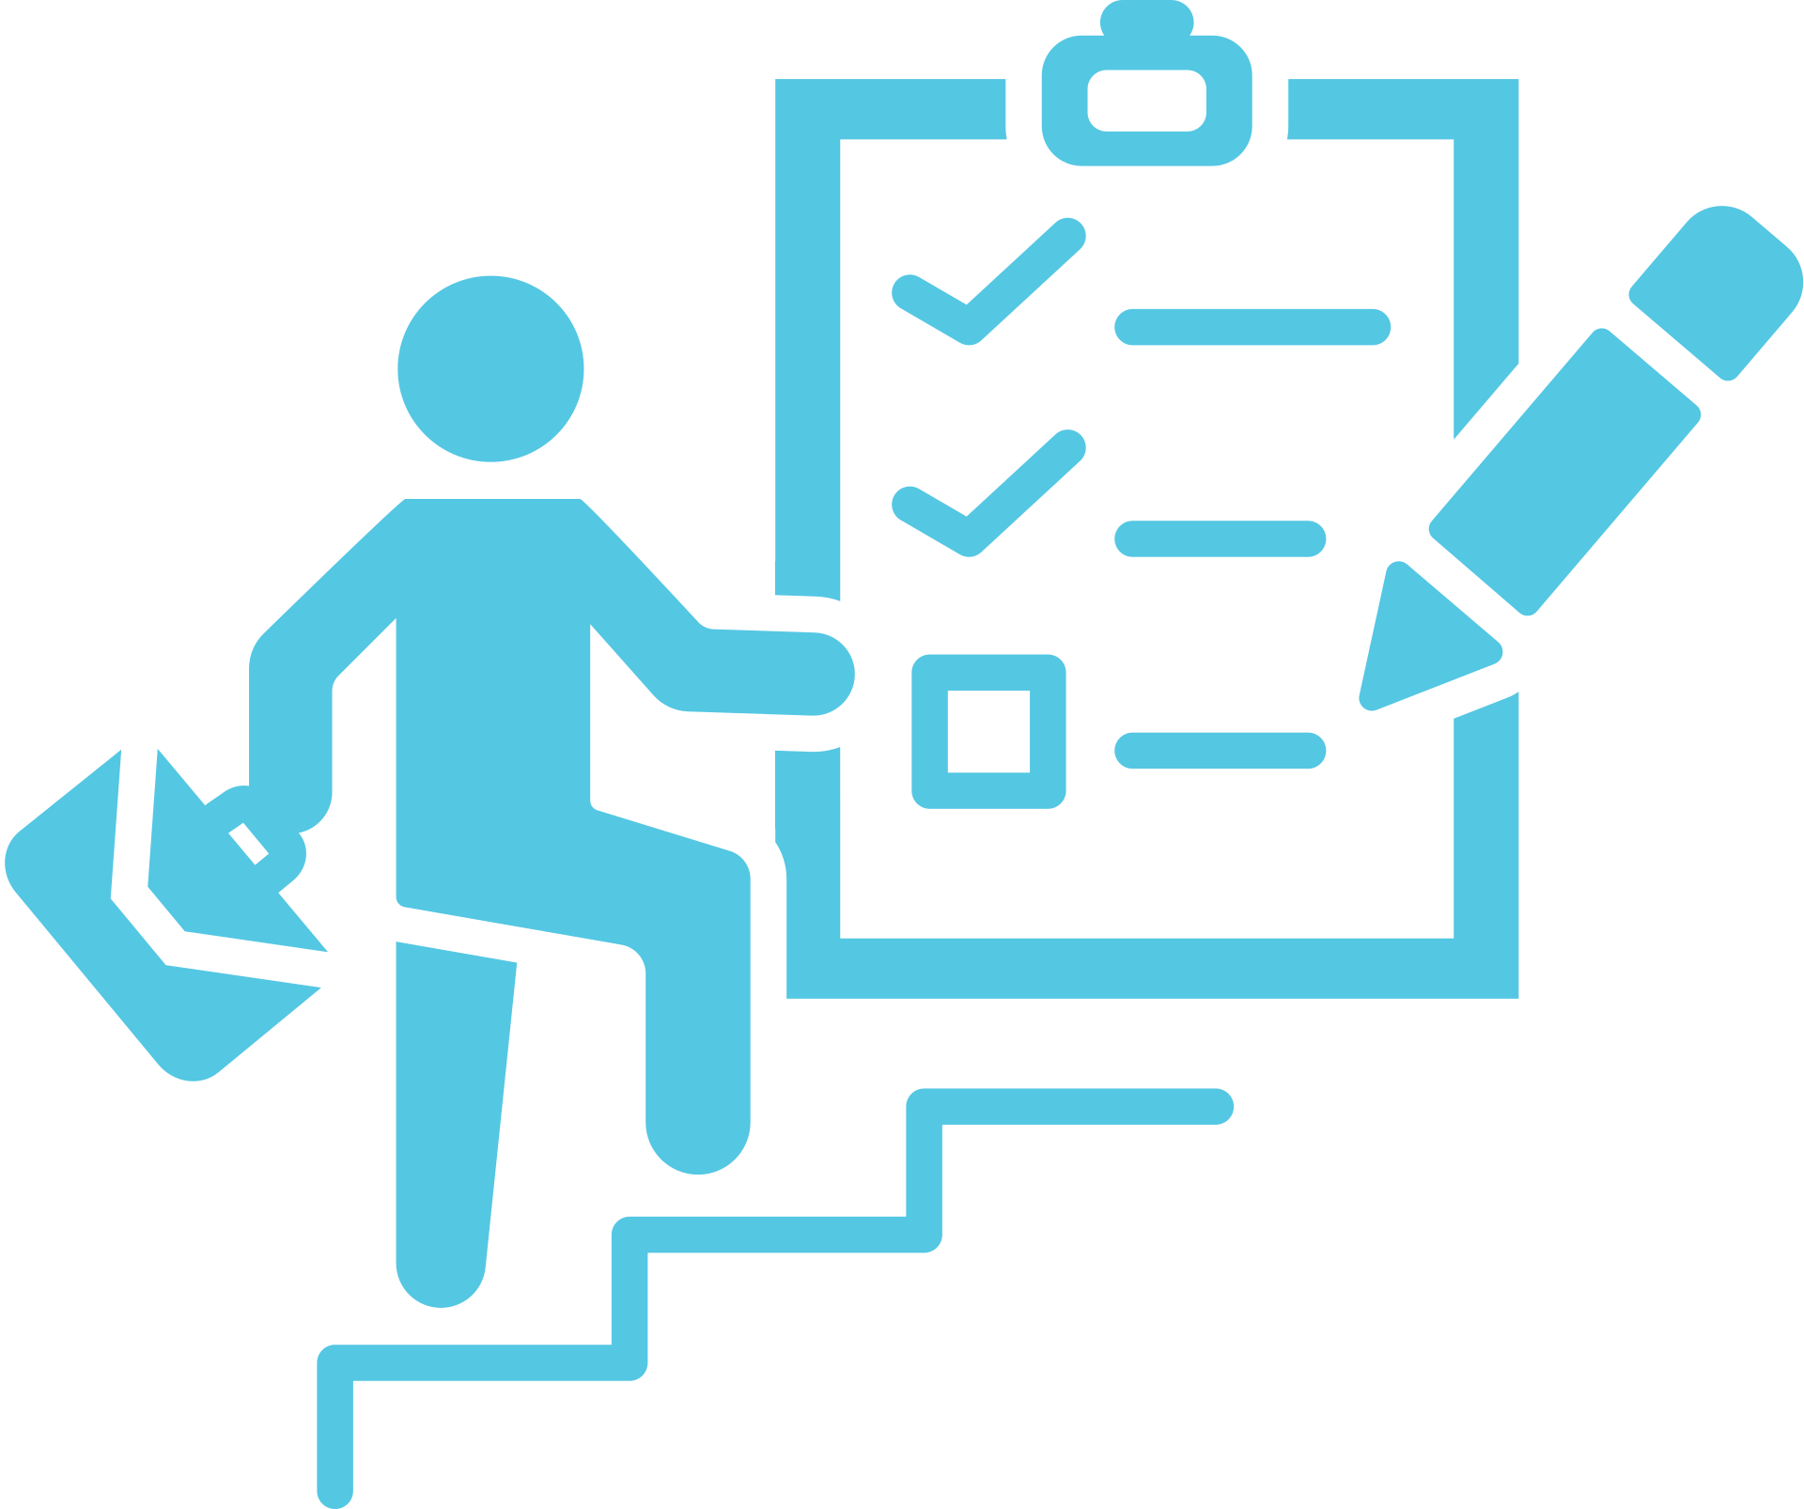

Conclusion and Future Work
  Significant Speed Improvement: UDAAN enhances translation efficiency, achieving a 3 to 3.5 times faster translation process compared to traditional methods.
  Innovative Post-Editing Features: The tool introduces advanced post-editing capabilities, including lexically constrained MT, to significantly improve translation quality and reduce editing efforts.
3.Future Enhancements: Plans include developing a web interface for online use, incorporating context-sensitive and morphologically-aware techniques for smarter replacement suggestions.
4.Continuous MT Performance Improvement: Future work aims to refine MT quality through a feedback loop using data from user edits, focusing on producing semantically and syntactically accurate translations.

Slide 15
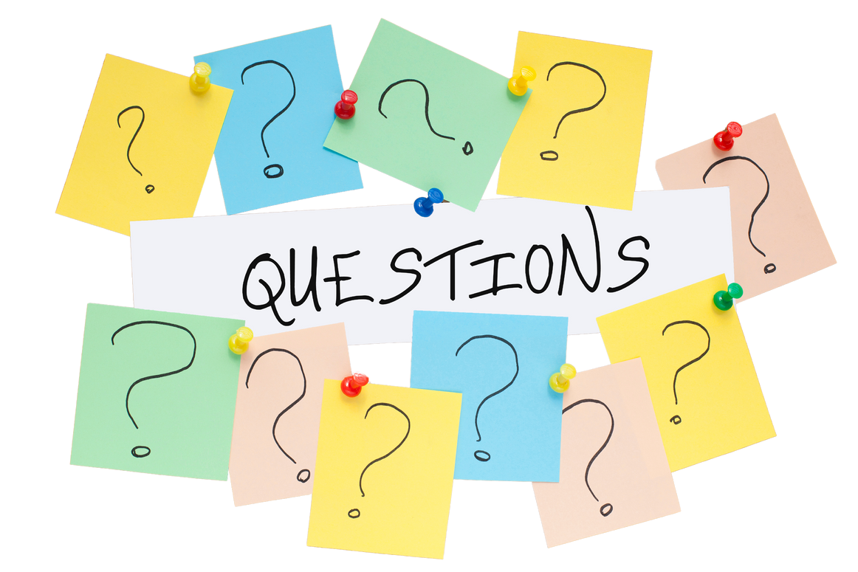
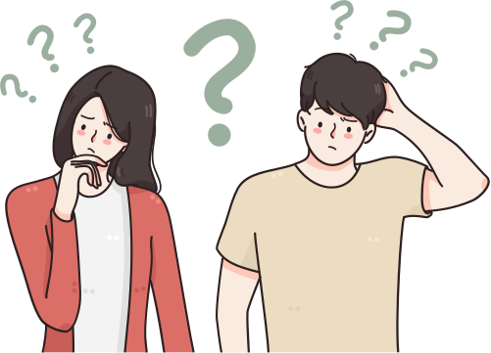
Thank You
Some References
  Ashish Vaswani, Noam Shazeer, Niki Parmar, Jakob Uszkoreit, Llion Jones, Aidan N Gomez, Łukasz Kaiser, and Illia Polosukhin. 2017..
  "Samanantar: The Largest Publicly Available Parallel Corpora Collection for 11 Indic Languages." arXiv:2104.05596 [cs.CL].
  "fairseq: A Fast, Extensible Toolkit for Sequence Modeling." In Proceedings of NAACL-HLT 2019: Demonstrations.
  "Attention is All You Need." In Advances in neural information processing systems. 5998–6008

